Slide 1
Applets Programming
Enabling Application Delivery Via the Web

Slide 2
Introduction
Applets are small Java programs that are embedded in Web pages.
They can be transported over the Internet from one computer (web server) to another (client computers).
They transform web into rich media and support the delivery of applications via the Internet.

Slide 3
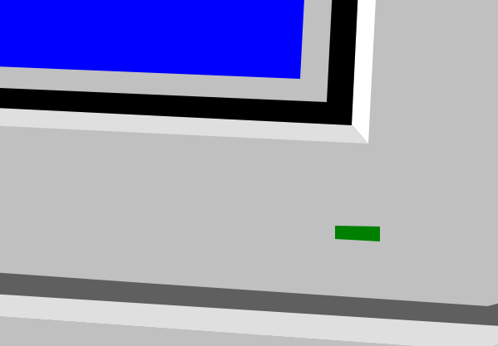
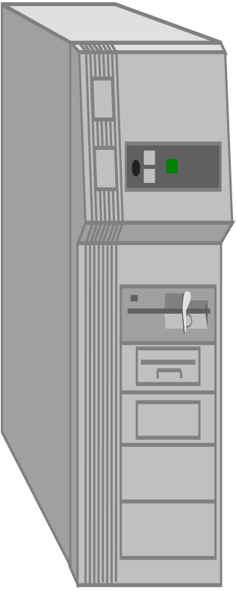
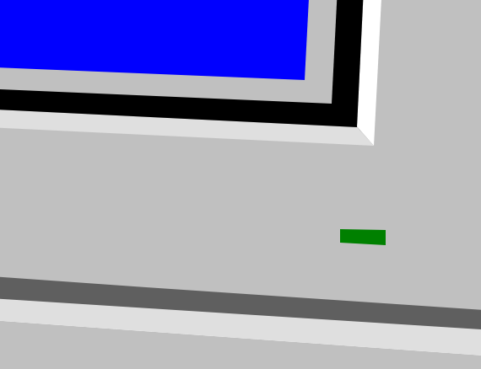
Applet: Making Web Interactive and Application Delivery Media
1
2
3
4
5
APPLET Development “hello.java”
AT
SUN.COM
hello.class
AT SUN’S
WEB SERVER
Create Applet
tag in HTML
document
Accessing
from
Your Organisation
The browser creates
a new window and
a new thread and
then runs the code
Hello Java
<app=
“Hello”>
The Internet
Hello

Slide 4
How Applets Differ from Applications
Although both the Applets and stand-alone applications are Java programs, there are certain restrictions are imposed on Applets due to security concerns:
Applets don’t use the main() method, but when they are load, automatically call certain methods (init, start, paint, stop, destroy).
They are embedded inside a web page and executed in browsers.
They cannot read from or write to the files on local computer.
They cannot communicate with other servers on the network.
They cannot run any programs from the local computer.
They are restricted from using libraries from other languages.
The above restrictions ensures that an Applet cannot do any damage to the local system.

Slide 5
Building Applet Code: An Example
//HelloWorldApplet.java
import java.applet.Applet;
import java.awt.*;
public class HelloWorldApplet extends Applet {
public void paint(Graphics g) {
g.drawString ("Hello World of Java!",25, 25);
}
}

Slide 6
Embedding Applet in Web Page
<HTML>
<HEAD>
<TITLE>
Hello World Applet
</TITLE>
</HEAD>
<body>
<h1>Hi, This is My First Java Applet on the Web!</h1>
<APPLET CODE="HelloWorldApplet.class" width=500 height=400>
</APPLET>
</body>
</HTML>

Slide 7
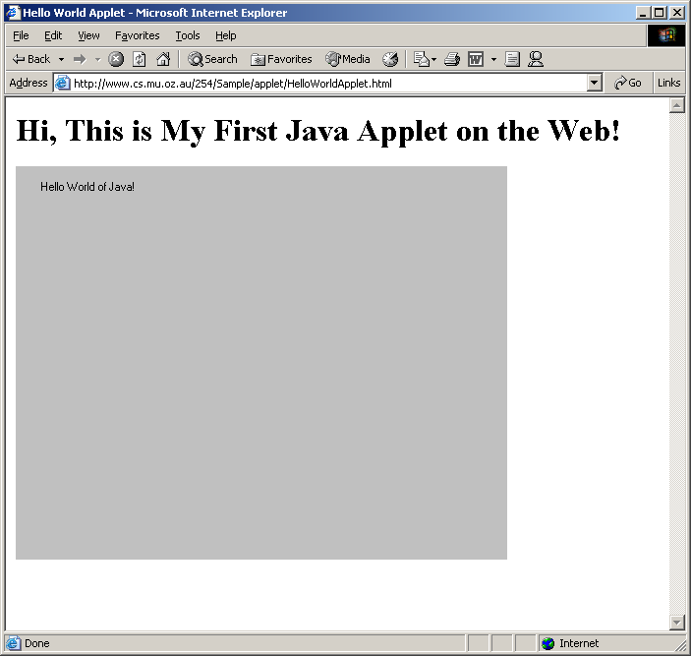
Accessing Web page (runs Applet)

Slide 8
Applet Life Cycle
Every applet inherits a set of default behaviours from the Applet class. As a result, when an applet is loaded, it undergoes a series of changes in its state. The applet states include:
Initialisation – invokes init()
Running – invokes start()
Display – invokes paint()
Idle – invokes stop()
Dead/Destroyed State – invokes destroy()

Slide 9
Applet States
Initialisation – invokes init() – only once
Invoked when applet is first loaded.
Running – invokes start() – more than once
For the first time, it is called automatically by the system after init() method execution.
It is also invoked when applet moves from idle/stop() state to active state. For example, when we return back to the Web page after temporary visiting other pages.
Display – invokes paint() - more than once
It happens immediately after the applet enters into the running state. It is responsible for displaying output.
Idle – invokes stop() - more than once
It is invoked when the applet is stopped from running. For example, it occurs when we leave a web page.
Dead/Destroyed State – invokes destroy() - only once
This occurs automatically by invoking destroy() method when we quite the browser.

Slide 10
Applet Life Cycle Diagram
init()
Born
Begin
stop()
start()
Running
Idle
destroy()
paint()
start()
Dead
End

Slide 11
Passing Parameters to Applet
<HTML>
<HEAD>
<TITLE>
Hello World Applet
</TITLE>
</HEAD>
<body>
<h1>Hi, This is My First Communicating Applet on the Web!</h1>
<APPLET
CODE="HelloAppletMsg.class" width=500 height=400>
<PARAM NAME="Greetings" VALUE="Hello Friend, How are you?">
</APPLET>
</body>
</HTML>

Slide 12
Applet Program Accepting Parameters
//HelloAppletMsg.java
import java.applet.Applet;
import java.awt.*;
public class HelloAppletMsg extends Applet {
String msg;
public void init()
{
msg = getParameter("Greetings");
if( msg == null)
msg = "Hello";
}
public void paint(Graphics g) {
g.drawString (msg,10, 100);
}
}
This is name of parameter specified in PARAM tag;
This method returns the value of paramter.

Slide 13
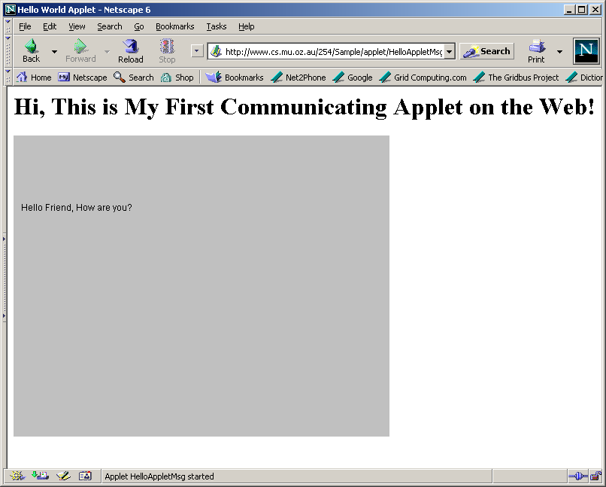
HelloAppletMsg.html

Slide 14
What happen if we don’t pass parameter? See HelloAppletMsg1.html
<HTML>
<HEAD>
<TITLE>
Hello World Applet
</TITLE>
</HEAD>
<body>
<h1>Hi, This is My First Communicating Applet on the Web!</h1>
<APPLET
CODE="HelloAppletMsg.class" width=500 height=400>
</APPLET>
</body>
</HTML>

Slide 15
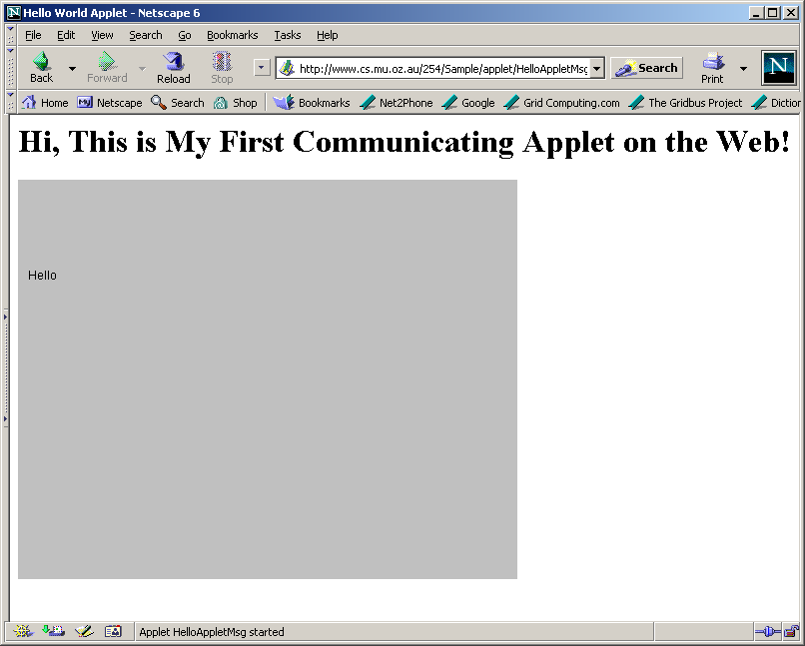
getParameter() returns null. Some default value may be used.

Slide 16
Displaying Numeric Values
//SumNums.java
import java.applet.Applet;
import java.awt.*;
public class SumNums extends Applet {
public void paint(Graphics g) {
int num1 = 10;
int num2 = 20;
int sum = num1 + num2;
String str = "Sum: "+String.valueOf(sum);
g.drawString (str,100, 125);
}
}

Slide 17
SunNums.html
<HTML>
<HEAD>
<TITLE>
Hello World Applet
</TITLE>
</HEAD>
<body>
<h1>Sum of Numbers</h1>
<APPLET CODE="SumNums.class" width=500 height=400>
</APPLET>
</body>
</HTML>

Slide 18
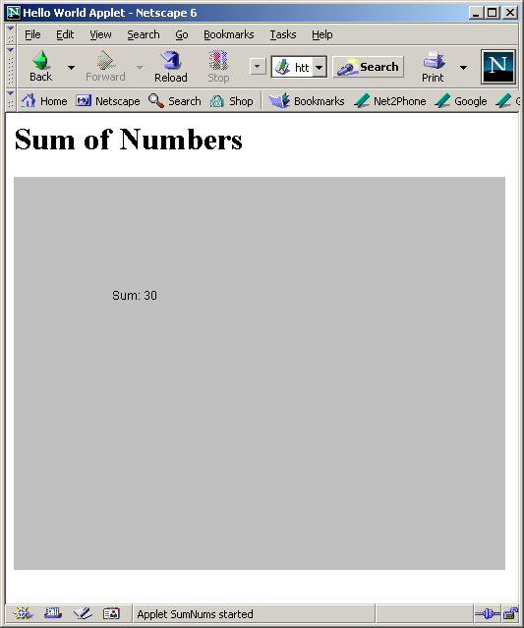
Applet – Sum Numbers

Slide 19
Interactive Applets
Applets work in a graphical environment. Therefore, applets treats inputs as text strings.
We need to create an area on the screen in which use can type and edit input items.
We can do this using TextField class of the applet package.
When data is entered, an event is generated. This can be used to refresh the applet output based on input values.

Slide 20
Interactive Applet Program..(cont)
//SumNumsInteractive..java
import java.applet.Applet;
import java.awt.*;
public class SumNumsInteractive extends Applet {
TextField text1, text2;
public void init()
{
text1 = new TextField(10);
text2 = new TextField(10);
text1.setText("0");
text2.setText("0");
add(text1);
add(text2);
}
public void paint(Graphics g) {
int num1 = 0;
int num2 = 0;
int sum;
String s1, s2, s3;
g.drawString("Input a number in each box ", 10, 50);
try {
s1 = text1.getText();
num1 = Integer.parseInt(s1);
s2 = text2.getText();
num2 = Integer.parseInt(s2);
}
catch(Exception e1)
{}

Slide 21
Interactive Applet Program.
sum = num1 + num2;
String str = "THE SUM IS: "+String.valueOf(sum);
g.drawString (str,100, 125);
}
public boolean action(Event ev, Object obj)
{
repaint();
return true;
}
}

Slide 22
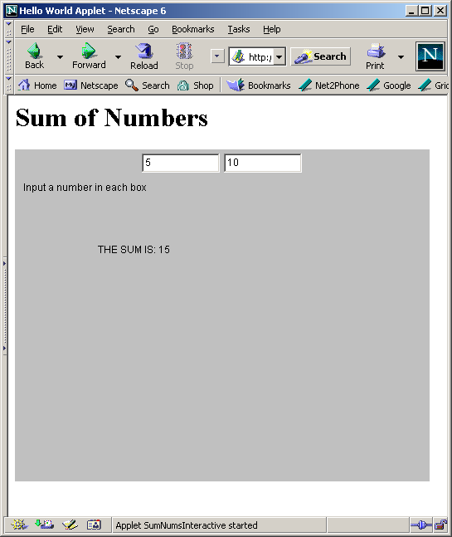
Interactive Applet Execution

Slide 23
Summary
Applets are designed to operate in Internet and Web environment. They enable the delivery of applications via the Web.
This is demonstrate by things that we learned in this lecture such as:
How do applets differ from applications?
Life cycles of applets
How to design applets?
How to execute applets?
How to provide interactive inputs?

